Slide 1
Legend :
No extra reward
Extra L reward
Extra R reward
0
Trial number
2000

Slide 2
Stimulus
Action
Reward block
Reward
Less than 0
(correct decision
Left)
Left
Extra L reward
1 + extra
Extra R reward
1
No extra reward
1
Right
Any
0
More than 0
(correct decision
Right)
Left
Any
0
Right
Extra L reward
1
Extra R reward
1 + extra
No extra reward
1
0
(correct decision randomly assigned to be Left/ Right)
Left
Extra L reward
1 + extra
Extra R reward
1
No extra reward
1
Right
Extra L reward
1
Extra R reward
1 + extra
No extra reward
1

Slide 3
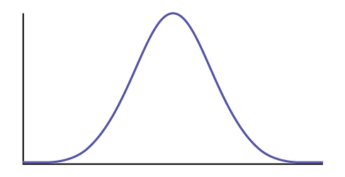
Stimulus
Correct choice
START
S
AGENT
^
S
Compute belief
Compute
Q
Compute noisy stimulus
μ = s
Decision based on
argmax{Q[L], Q[R]}
Wrong/ Correct ?
action
A
Q
Update Q-values
for the next trial
Error in prediction
δ = R - Q
reward
R

Slide 4
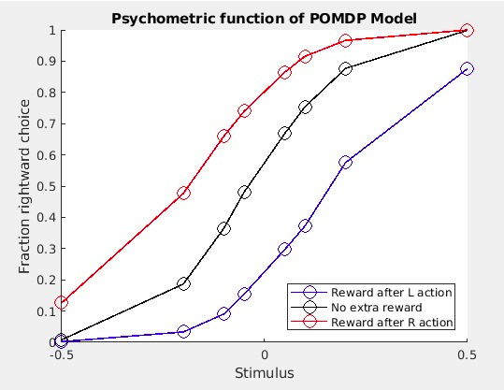

Slide 5
